Slide 1
Insights Report for Marketing Analysis Power BI Project
-Vennila Ravichandran

Slide 2
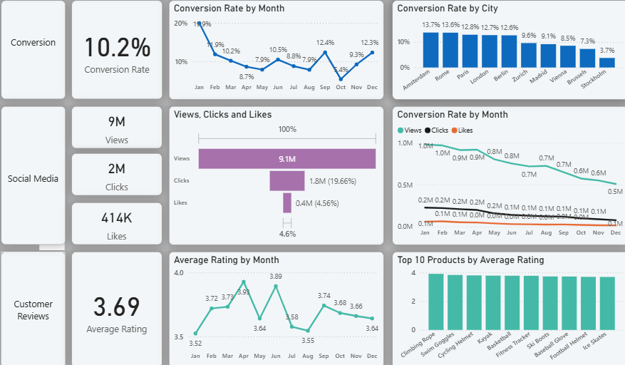
Overview
Decreased Conversion Rate:
The conversion rate was quite good during the start of the year but gradually declined throughout the year and noticed a drastic dip during October. However, it had an impressing rebound again at December.
Stockholm noticed the least conversion rate, whereas Amsterdam has the highest conversion rate.
Reduced Customer Engagement:
There is an overall decline in social media engagement with views declining throughout the year.
While the clicks and likes are low compared to views, the click-through rate stands at 19.6% ensuring that engaged users are still interacting effectively.
Customer Feedback Analysis:
Customer Ratings have been consistent throughout the year standing at 3.69.
Although the ratings are stable, it is below the target of 4.0. Hence there is need for focused improvement on customer satisfaction for the products below 3.5 rating.

Slide 3
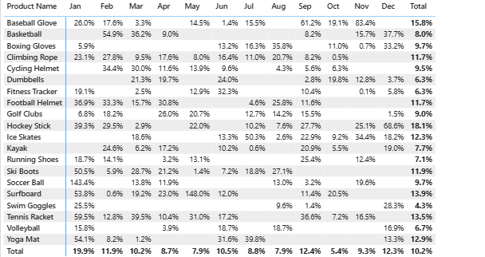
Decreased Conversion Rates
General Conversion Trend:
Throughout the year the converion rates are greatly varied, with higher number of products converting succesfully in the months of January and December. This suggests that while some products have strong seasonal peaks, there is a potential to improve conversions in lower performing months through targeted interventions.
Lower Conversion Trend:
October experienced the lowest conversion rate with no products significantly showing any conversion. This emphasizes on the need to revisit potential marketing strategies or promotions to enhance perfomance during that particular period.
Higher Conversion Trend:
January recorded the highest overall conversion rate at 19.9%, driven significantly by the SoccerBall(143.4%), Ski Boots(50%),Surfboard(53.8%),Tennis Racket(59.5%),Yoga Mat(54.1%) conversion. This indicates a strong start to the year, likely fueled by seasonal demand and effective marketing strategies.

Slide 4
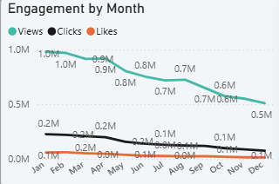
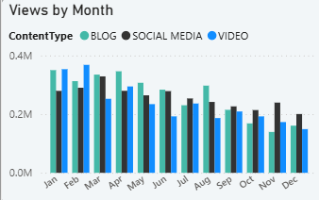
Reduced Customer Engagement
Declining Views:
The views has been steadily declining since the start of the year though there is a slight improvement noticed from March to April. But again from April to December the views declined to half the amount as it was initially, indicating the reduced engagement in second half of the year.
Lower Interaction Rates:
Clicks and likes remained consistently low compared to views, suggesting the need for more engaging content or stronger calls to action.
Content Type performnace:
The Blog and the social media content is doing equally well in terms of views and steadiness throughout the year.
While the video content had a great start from beginning of the year in terms of views but gradually declined indicating slightly lower engagement compared to Blogs and Social media.

Slide 5
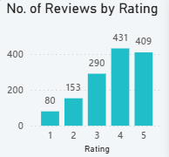
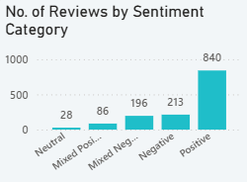
Customer Feedback Analysis
Customer Ratings Distribution:
The majority of customer reviews are in the higher ratings, with 431 reviews at 4 stars and 409 reviews at 5 stars, indicating overall positive feedback. Lower ratings (1-2 stars) account for a smaller proportion, with 80 reviews at 1 star and 153 reviews at 2 stars.
Sentiment Analysis:
Positive sentiment dominates with 840 reviews, reflecting a generally satisfied customer base. Negative sentiment is present in 213 reviews, with a smaller number of mixed and neutral sentiments, suggesting some areas for improvement but overall strong customer approval.
Opportunity for Improvement:
The presence of mixed positive and mixed negative sentiments suggests that there are opportunities to convert those mixed experiences into more clearly positive ones, potentially boosting overall ratings. Addressing the specific concerns in mixed reviews could elevate customer satisfaction.

Slide 6
Goals & Actions
Goals
Actions
Increase Conversion Rates:
Goal: Identify factors impacting the conversion rate and provide recommendations to improve it.
Insight: Highlight key stages where visitors drop off and suggest improvements to optimize the conversion funnel.
Enhance Customer Engagement:
Goal: Determine which types of content drive the highest engagement.
Insight: Analyze interaction levels with different types of marketing content to inform better content strategies.
Improve Customer Feedback scores:
Goal:Understand common themes in customer reviews and provide actionable insights.
Insight:Identify recurring positive and negative feedback to guide product and service improvements
Increase Conversion Rates:
Target High-Performing Product Categories: Focus marketing efforts on products with demonstrated high conversion rates, such as Soccer Balls, Ski Boots,Tennis Racket and Baseball Gloves. Implement seasonal promotions or personalized campaigns during peak months (e.g., January and November) to capitalize on these trends.
Enhance Customer Engagement:
Revitalize Content Strategy: To turn around declining views and low interaction rates, experiment with more engaging content formats, such as interactive videos or user-generated content. Additionally, boost engagement by optimizing call-to-action placement in social media and blog content, particularly during historically lower-engagement months (April-December).
Improve Customer Feedback scores:
Address Mixed and Negative Feedback: Implement a feedback loop where mixed and negative reviews are analyzed to identify common issues. Develop improvement plans to address these concerns. Consider following up with dissatisfied customers to resolve issues and encourage re-rating, aiming to move average ratings closer to the 4.0 target.

